Slide 1
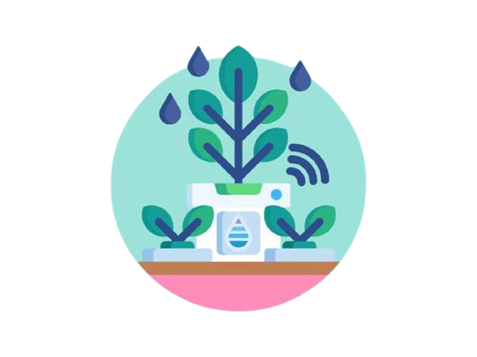
Smart Irrigation System
A soil moisture sensor, and a water pump to automate
the process of watering plants
(17-03-2023)
Annu Shukla
200013139026
Btech(CSE) 3rd Year
Priyanshu Gupta
200014045037
BCA 3rd Year

Slide 2
INTRODUCTION
The Smart Irrigation System automates plant watering using a Raspberry Pi, a soil moisture sensor, and a water pump. It solves the problem of time-consuming and suboptimal manual watering by continuously measuring soil moisture and adjusting water flow accordingly. The result is healthier plants and saved time.
The Smart Irrigation System solves the problem of inefficient and inconsistent manual watering of plants. Manual watering can be time-consuming and lead to under- or over-watering, affecting plant health. The system automates plant watering using a soil moisture sensor and water pump, ensuring optimal moisture levels for healthy plant growth without manual intervention.

Slide 3
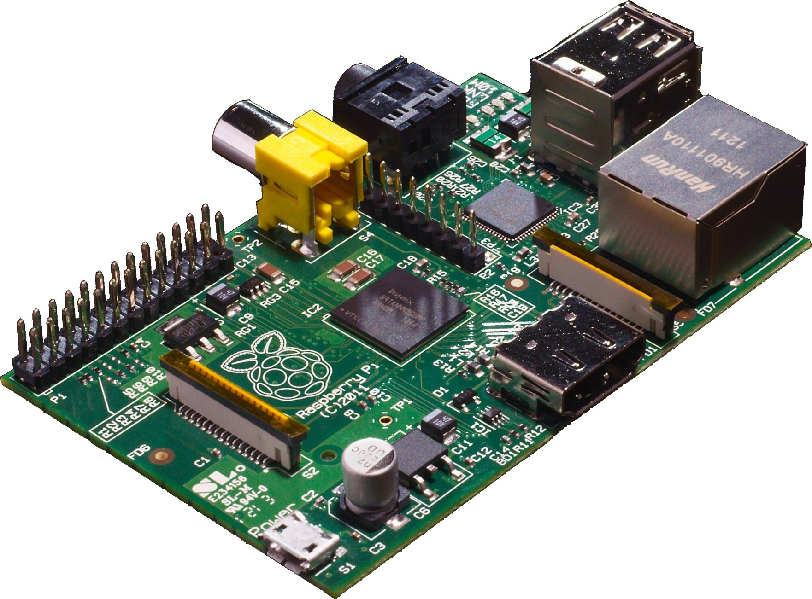
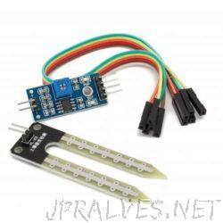
PROJECT OVERVIEW
The Smart Irrigation System project uses a combination of hardware and software components to automate the process of watering plants. Here's an overview of the key components:
Raspberry Pi: A credit card-sized computer that runs the software needed to control the system. The Raspberry Pi is connected to the soil moisture sensor and the water pump and acts as the brain of the system.
Soil Moisture Sensor: A sensor that measures the moisture level of the soil. The sensor is inserted into the soil near the plant and sends a signal to the Raspberry Pi, which uses this information to determine whether the plant needs to be watered.
Water Pump: A pump that delivers water to the plant when it needs to be watered. The pump is controlled by the Raspberry Pi, which turns it on or off based on the readings from the soil moisture sensor.
Raspberry Pi
Soil Moisture Sensor

Slide 4
How it works?
The components of the Smart Irrigation System work together to automate the process of watering plants in the following way:
The soil moisture sensor continuously measures the moisture level of the soil around the plant.
The Raspberry Pi reads the data from the soil moisture sensor and determines whether the soil is dry enough to require watering.
If the soil is dry, the Raspberry Pi sends a signal to the water pump to turn it on and start delivering water to the plant.
The water pump delivers water to the plant until the soil moisture sensor indicates that the soil is sufficiently moist.
Once the soil reaches the desired moisture level, the Raspberry Pi sends a signal to the water pump to turn it off and stop delivering water to the plant.
This process repeats on a regular basis, ensuring that plants receive the optimal amount of water for their growth and health, without the need for manual intervention.

Slide 5
In this diagram, the Raspberry Pi is connected to both the soil moisture sensor and the water pump through its GPIO (General Purpose Input/Output) pins. The soil moisture sensor provides an analog output that is read by one of the GPIO pins on the Raspberry Pi, while another GPIO pin is used to send a control signal to the water pump. The power supply for the water pump is also connected separately to ensure that it has sufficient power to operate.
HARDWARE SETUP
Raspberry Pi
GPIO Pins
Soil Moisture Sensor
Analog Output
Water Pump
Power Supply Control Signal
Figure:
Diagram showing the connection between the Raspberry Pi, soil moisture sensor, and water pump:

Slide 6
Brief explanation of each connection
Raspberry Pi GPIO pins: The GPIO pins on the Raspberry Pi are used to connect it to other hardware components in the system. In this case, one GPIO pin is used to read the analog output from the soil moisture sensor, while another GPIO pin is used to send a control signal to the water pump.
Soil moisture sensor analog output: The soil moisture sensor provides an analog output signal that is proportional to the moisture level in the soil. This signal is connected to one of the Raspberry Pi's GPIO pins, which can read the voltage level and convert it into a digital value that can be processed by the software.
Water pump power supply: The water pump requires a separate power supply to operate, which is connected to a power source (such as a battery or AC outlet) and then to the pump itself. This ensures that the pump has sufficient power to operate and can deliver water to the plants effectively.
Water pump control signal: The Raspberry Pi sends a control signal to the water pump via another GPIO pin. This signal tells the pump when to turn on or off based on the moisture level in the soil. When the soil is dry, the Raspberry Pi sends a signal to turn the pump on and deliver water to the plants. When the soil is sufficiently moist, the Raspberry Pi sends a signal to turn the pump off and stop delivering water.

Slide 7
SOFTWARE SETUP
Steps to install required Python libraries(gpiozero, Flask)
To install the required Python libraries gpiozero and Flask, you can follow these steps:
Open a terminal or command prompt on your computer.
Make sure you have Python installed by typing python or python3 in the terminal. If you get an error message or see a version number lower than 3.5, you will need to install Python 3 from the official website.
Install gpiozero by typing pip install gpiozero in the terminal. This will download and install the library from the Python Package Index.
Install Flask by typing pip install Flask in the terminal. This will download and install the library from the Python Package Index.
You can now import these libraries in your Python code by including the following lines at the beginning of your file:
from gpiozero import OutputDevice
from flask import Flask, render_template, request

Slide 8
Steps to clone or download the project repository
To clone or download the project repository, these steps were followed:
Open the project's GitHub repository in your web browser.
Click on the green "Code" button.
If Git is already installed on computer, click on "Open with GitHub Desktop" or "Download ZIP". If not, click on "Download ZIP".
If you clicked on "Open with GitHub Desktop", choose a directory to clone the repository to and click "Clone".
If you clicked on "Download ZIP", extract the contents of the ZIP file to a directory of your choice.

Slide 9
Steps to run the Flask web application:
Open the command prompt/terminal and navigate to the project directory.
Activate the virtual environment using the command: source venv/bin/activate (for Linux/MacOS) or venv\Scripts\activate (for Windows)
Set the Flask app environment variable using the command: export FLASK_APP=app.py (for Linux/MacOS) or set FLASK_APP=app.py (for Windows)
Set the Flask environment to development mode using the command: export FLASK_ENV=development (for Linux/MacOS) or set FLASK_ENV=development (for Windows)
Run the Flask app using the command: flask run
Open a web browser and go to the URL: http://localhost:5000 to access the web application.

Slide 10
How the web interface works?
The web interface provides a simple and user-friendly way for users to interact with the water pump. It consists of a single page that displays the current status of the water pump and allows users to manually turn it on or off.
When the user visits the web page, the Flask application reads the current status of the water pump from the GPIO pin connected to the pump. If the pump is currently on, the web page displays a message indicating that the pump is running. If the pump is off, the web page displays a message indicating that the pump is currently not running.
To manually turn the water pump on or off, the user can simply click the "Turn On" or "Turn Off" button on the web page. When the user clicks the "Turn On" button, the Flask application sets the GPIO pin connected to the water pump to "on" and the pump starts running. Similarly, when the user clicks the "Turn Off" button, the Flask application sets the GPIO pin connected to the water pump to "off" and the pump stops running.
Overall, the web interface provides an easy-to-use way for users to monitor and control the water pump remotely, without having to manually interact with the GPIO pins or the command line.

Slide 11
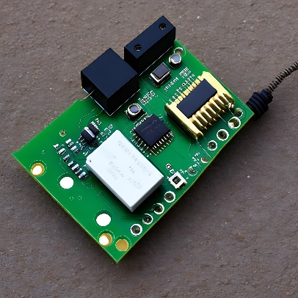
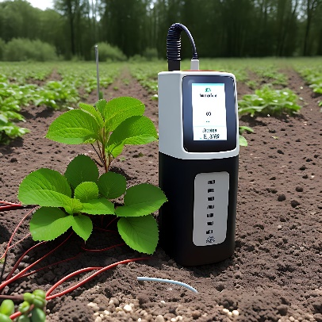
RESULTS
The project is able to successfully automate the process of watering plants based on soil moisture levels. The Raspberry Pi reads the soil moisture sensor and turns the water pump on or off accordingly. The Flask web application also provides an user-friendly interface for manual control of the water pump. The project has been set up correctly and is able to maintain optimal soil moisture levels for healthy plant growth.

Slide 12
Conclusion and future improvements
In conclusion, the project successfully automated the process of watering plants using a Raspberry Pi, soil moisture sensor, and water pump. With the help of the Flask web interface, users can easily monitor the soil moisture level and control the water pump manually.
As for future improvements, here are a few suggestions:
Using a more accurate sensor to measure the soil moisture level.
Adding more sensors to monitor other environmental factors like temperature and humidity.
Implementing a scheduling feature that automatically waters the plants at specific intervals.
Implementing a notification system to alert users when the soil moisture level is too low or too high.
Using machine learning algorithms to optimize the watering process based on the plant species and environmental factors.

Slide 13
REFERENCES
The official websites for the Raspberry Pi (https://www.raspberrypi.org/) and Python (https://www.python.org/)
The documentation for the gpiozero library (https://gpiozero.readthedocs.io/)
Online forums and communities such as the Raspberry Pi forum (https://www.raspberrypi.org/forums/)
Python subreddit (https://www.reddit.com/r/Python/) to find information and ask questions related to the project

